Slide 1
Digital Board Marker
(Storage Efficient System)
Boost your learning to new heights

Slide 2



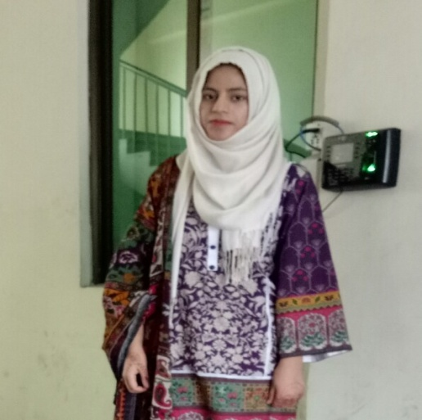
OUR CREATIVE TEAM MEMBERS
Haris Khan
Hamza Farooq
Komal Shehzadi
Ayesha Atif

Slide 3
Introduction
Digital Board Marker solves the storage issue
and provide a size efficient, bandwidth efficient lecture recording system.

Slide 4
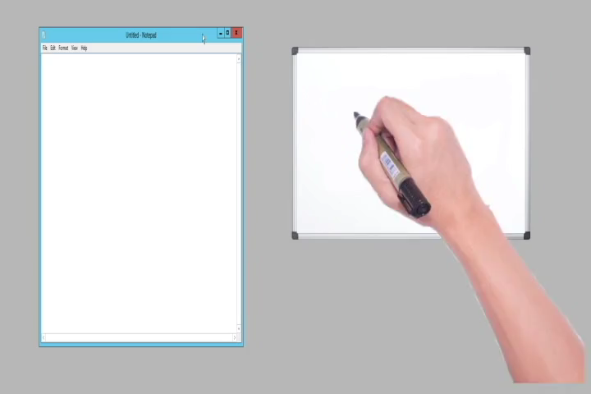
Demo Video

Slide 5
Problem Statement
To make a storage and bandwidth efficient system with a lecture player and learning management
system for students and educational institutes

Slide 6
TARGET MARKET
Educational
Institutes
Training Centers
Sketch Artists

Slide 7




OUR COMPETITORS

Slide 8
Comparison With Existing Systems
Initiative | Storage Efficiency | Free to Access | Quality | Storage Space
Edx | ✕ | ✓ | 360p | 1.9MB/min
Coursera | ✕ | ✓ | 360p | 1.8MB/min
Udemy | ✕ | ✕ | 360p | 2.0MB/min
Udacity | ✕ | ✓ | 360p | 1.8MB/min
DBM | ✓ | ✓ | Max | 18KB/min

Slide 9





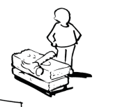



Key Partners | Key Activities | Value Propositions |  | Customer Relationships | Customer Segments
 | Key Resources |  |  | Channels
Cost Structure |  |  | Revenue Streams
PCB, IoT modules Manufactures and Retailers
Development of IoT hardware
Development of LMS web application
B2C Market
-No need of expensive camcorders
-Less internet usage
-Faster upload speeds
-Faster download and play speeds
Students that need jotting down the lecture
Students that cannot remember each and every word said by teacher in the class
Students that face less storage issue while storing lectures
Students that face less internet data issue while downloading lectures
Students that want to access lectures their own class lectures online
-Official Website
-Blog/Facebook Page
-Social Network
-Telephone
-Customer Congress
Development of Offline player application
Perform product research and take surveys
Cloud Computing Internet Service Provider
Lecture Content as documents and animation files (Virtual)
B2B Market
-More Student concentration
-Less student effort
-Storage efficiency
-Sufficient Lecture data storage capacity
-Low internet bandwidth required
-Social media Adverts
-Online Shop Platforms
-Direct Sale to Education institutes
-Seminars and presentations held in Education institutes
Investors and Lobbyists
Marker hardware, Web server and controller computers (Physical)
LMS and Offline player (Virtual)
-Online Lecturers
-Artists that need to record their work
(Software)
LMS (Adverts, Rs 20, 000)
Controller App, Offline Player (Adverts)
Permanent employees and maintainers (-50% of the Revenue)
(Hardware)
Digital Board Marker hardware (Rs 8, 500)
Desktop PC (Rs 2000)
Central Server (Rs 5, 000)
17% of cost of Digital Board Marker Hardware that is Rs 1500 that is 150, 000 per 100 hardware modules sold
LMS, Controller App, Offline Player adverts that is Rs 100, 000 per month
Rs 20, 000 revenue on each LMS software sold

Slide 10
Investment
Amount of Rs 20,00,000 (twenty lac) required
for making
50 board marker units (Rs 525,000)
Hiring and paying workers
Marketing
Office Site
Sourced from
Tech incubators like plan9
Venture capitalists like Sarmayacar

Slide 11
Revenue Model
Revenue of 20% of cost of Digital Board Marker Hardware (Rs 1500/-)
Rs 20,000 revenue on each LMS software
In terms of affiliate marketing, Rs. 900 per 4000 views

Slide 12
Payback Period
Payback period of the entire investment will be 3 years with the grace period of 1 year.

Slide 13
Boost your learning to new heights.

Slide 14
Thank You!

